Slide 1
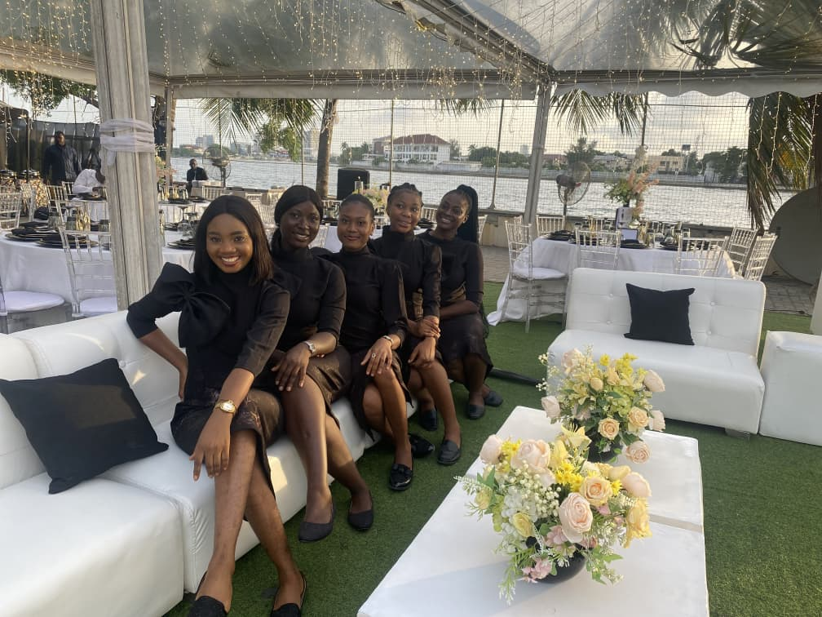

EVENT STAFFING
& HOSPITALITY SERVICES
CAPABILITY PROFILE
Where Hospitality Meets Style.

Slide 2
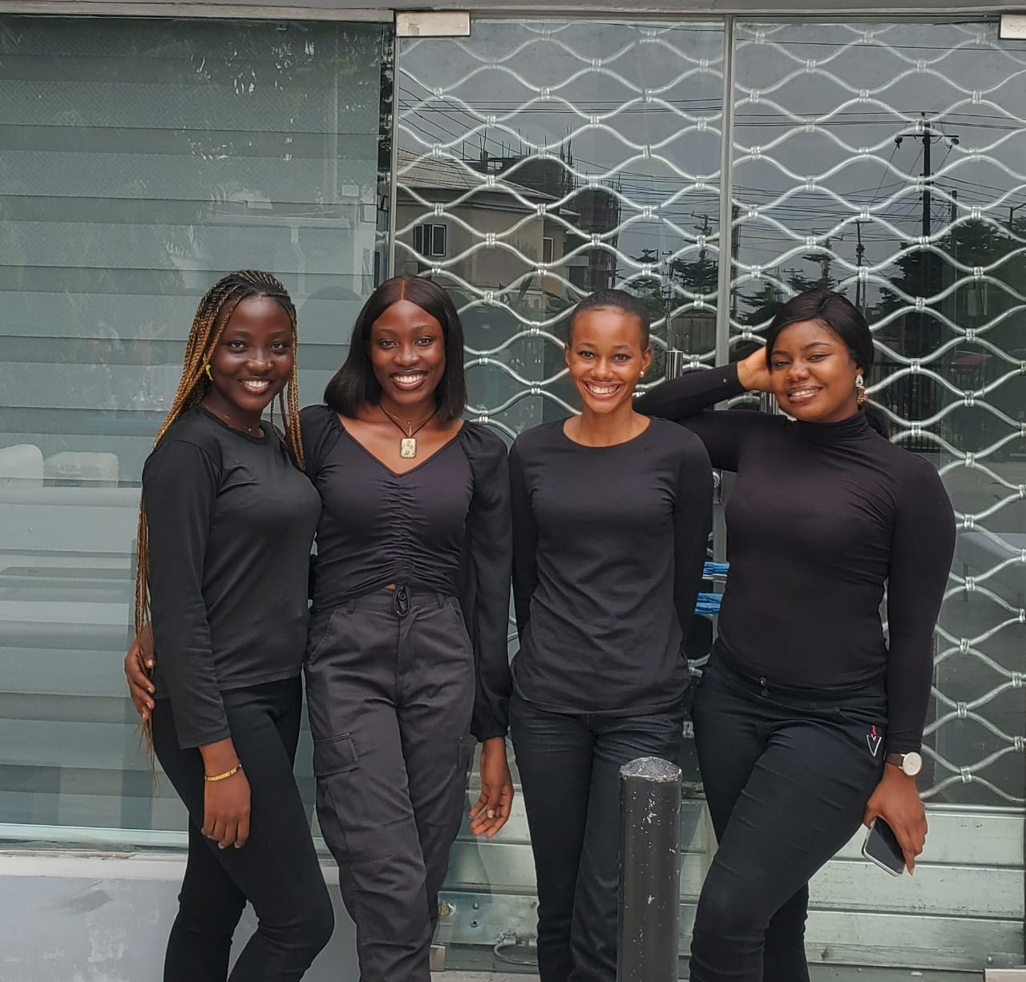


WHO WE ARE
About Us
Reni's Gallery Ltd. is a professional event staffing and guest management company based in Lagos, Nigeria. We provide polished, well-trained hospitality personnel who represent our clients' brands with confidence, warmth, and precision — across corporate, institutional, and large-scale events.
Mission
To deliver seamless guest experiences and professional event support that reflect the standards of the brands we represent.
Vision
To be West Africa's most trusted name in professional event staffing and guest management.
Core Values
Professionalism
Excellence
Integrity
Reliability
RENI'S GALLERY LTD.
02

Slide 3








WHAT WE DO
Our Services
Professional Ushers
Corporate Event Support
Guest Registration
Polished floor staff who guide and assist guests throughout the event.
End-to-end staffing for launches, seminars, and company functions.
Efficient check-in and accreditation for guests and delegates.
Guest Management
VIP Protocol
Conference Support
Coordinated guest flow, seating, and hospitality on the day.
Discreet, dedicated attention for high-profile guests and dignitaries.
Staffing for panels, sessions, and multi-day conferences.
AGM Support
Brand Activations
Social Events
Structured staffing for shareholder and annual general meetings.
On-brand representatives for product launches and activations.
Hospitality staffing for weddings, parties, and private functions.
RENI'S GALLERY LTD.
03

Slide 4






OUR VALUE
Why Choose Reni's Gallery
Professional Representation
Operational Excellence
Reliable Staffing
Our team presents your brand with polish, confidence, and warmth.
Structured processes from enquiry through post-event review.
Vetted, dependable personnel who show up prepared and on time.
Attention to Detail
Client Experience
Scalable Event Support
Every guest touchpoint is anticipated and managed with care.
Clear communication and accountability throughout every engagement.
Teams that scale from small gatherings to large public events.
RENI'S GALLERY LTD.
04

Slide 5







OUR PROCESS
How We Work
01
02
03
04
05
06
07
Enquiry
Consultation
Proposal
Planning
Staff Briefing
Event Execution
Post-Event Review
Every engagement follows this structured process — from first enquiry to a documented post-event review — so clients always know what to expect and when.
RENI'S GALLERY LTD.
05

Slide 6











WHERE WE WORK
Industries We Serve
Corporate
Financial Institutions
Government
NGOs
Educational Institutions
Hotels
Luxury Brands
Conferences
...and every
event in between.
Sports Events
Weddings
Private Events
RENI'S GALLERY LTD.
06

Slide 7
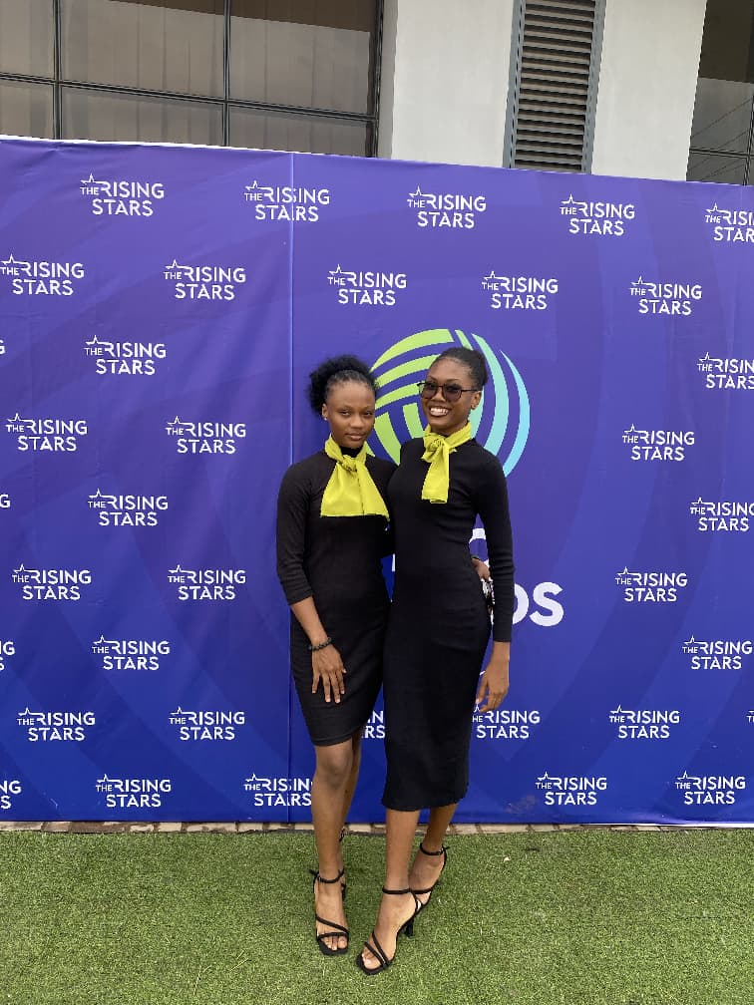
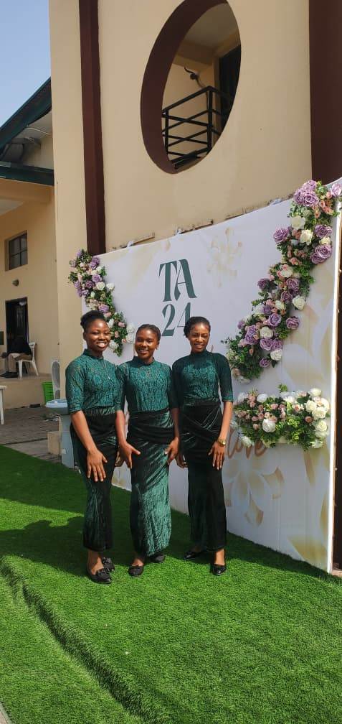
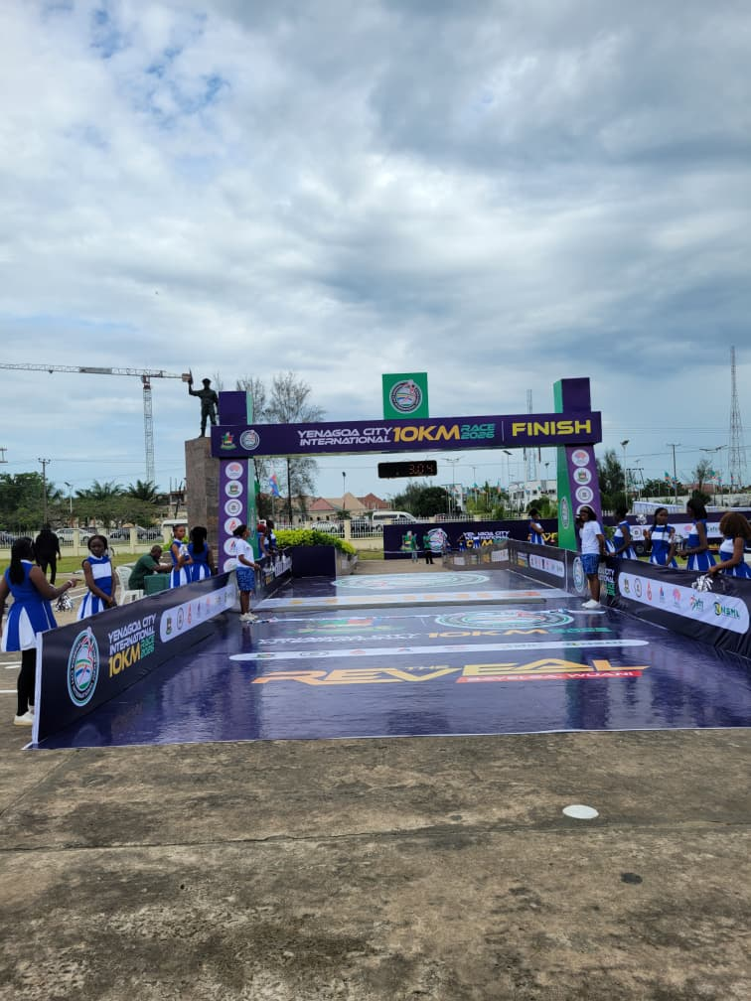
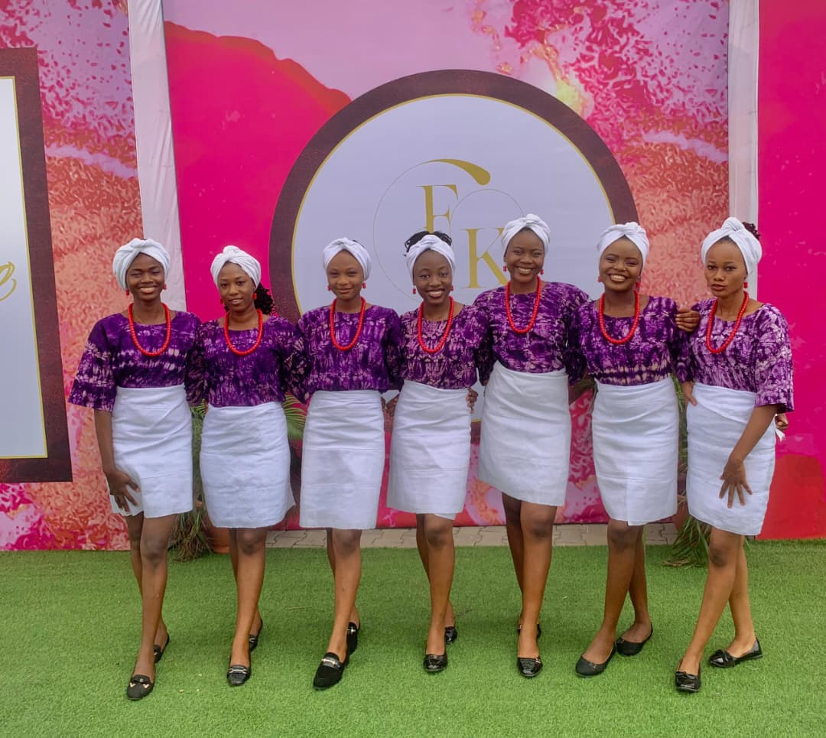
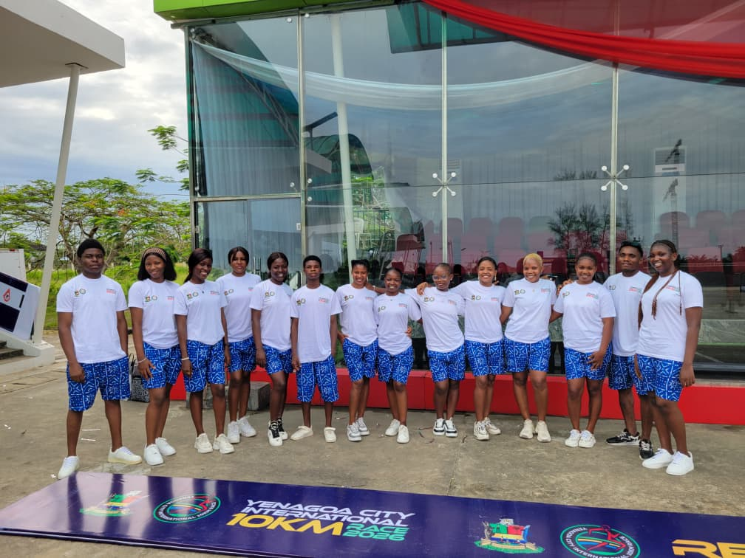
EVENT HIGHLIGHTS
Where We've Shown Up
Corporate Conference & Award Support
Wedding Hospitality Services
Sports Event Staffing
VIP Guest Management
Registration & Accreditation
Staffing high-visibility award ceremonies with poise and precision.
Elegant guest hospitality for private celebrations.
Coordinated crews supporting large-scale public sporting events.
Attentive, on-brand hosting for high-profile guests.
Organised check-in and accreditation for large event crowds.
RENI'S GALLERY LTD.
07

Slide 8
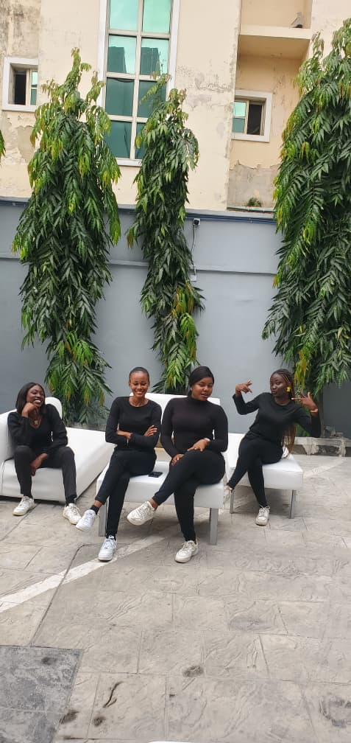






OUR STANDARDS
How We Show Up
Professional Grooming
Corporate Etiquette
Client-Centric Service
Communication
Punctuality
Confidentiality
Problem Solving
Team Coordination
Every team member is briefed, groomed, and reviewed against these standards before they represent a client on site.
RENI'S GALLERY LTD.
08

Slide 9
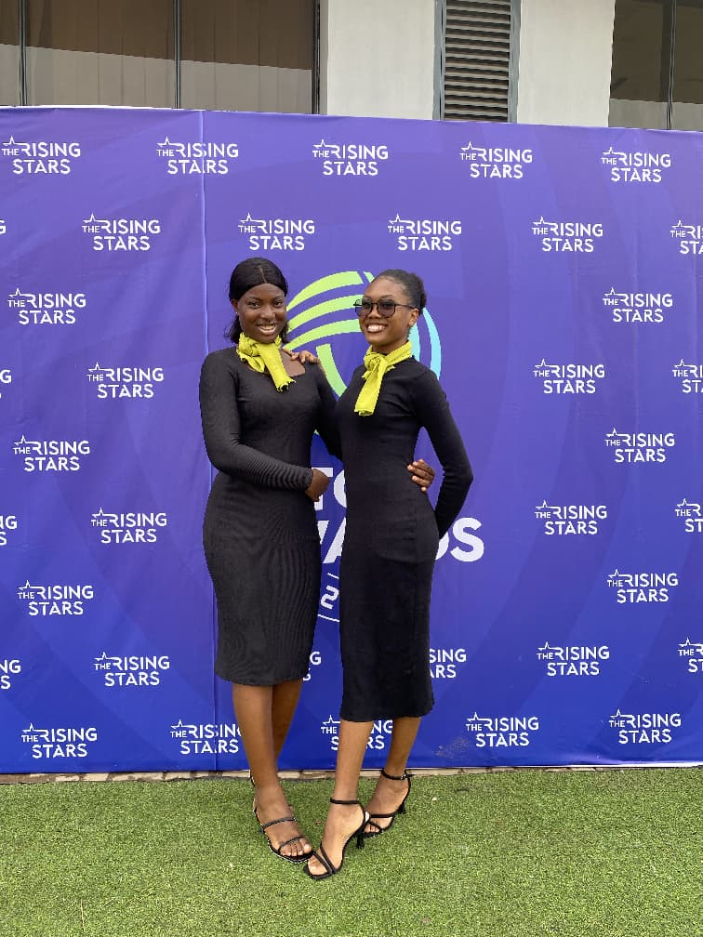
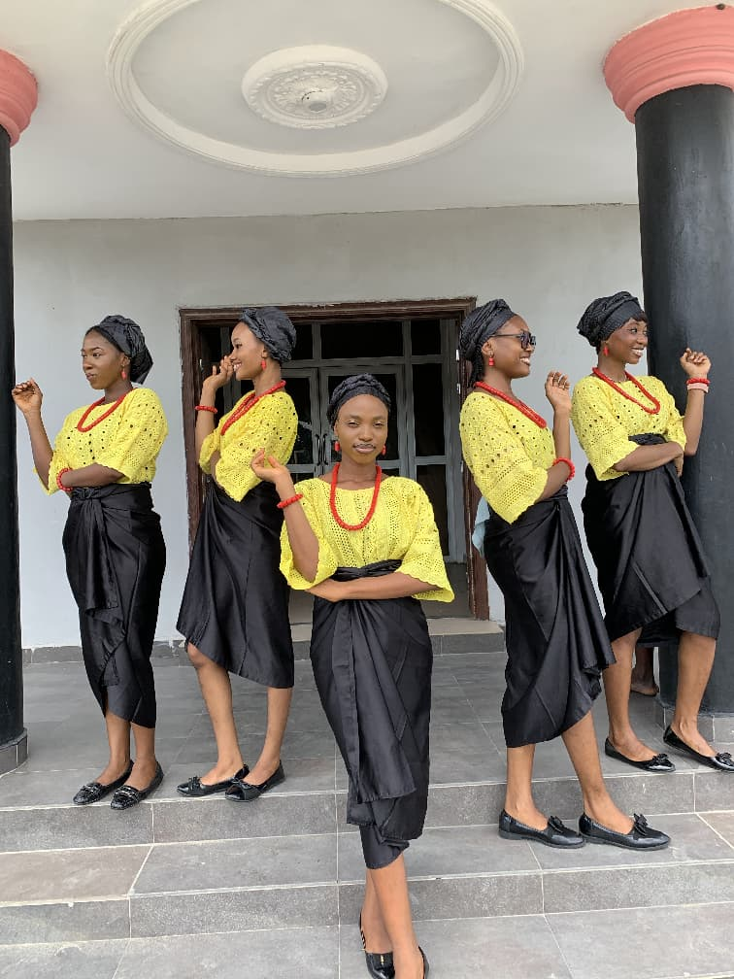
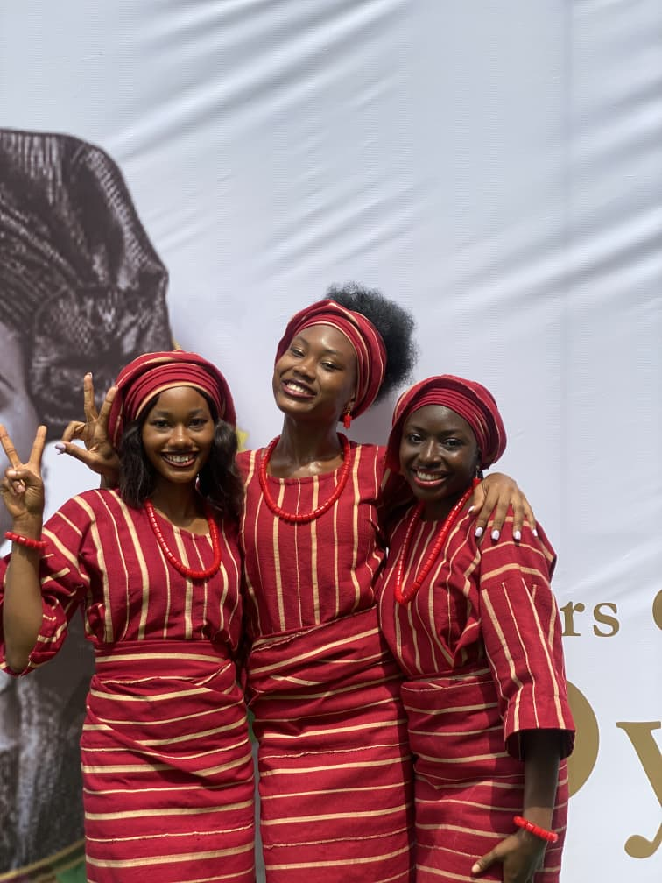
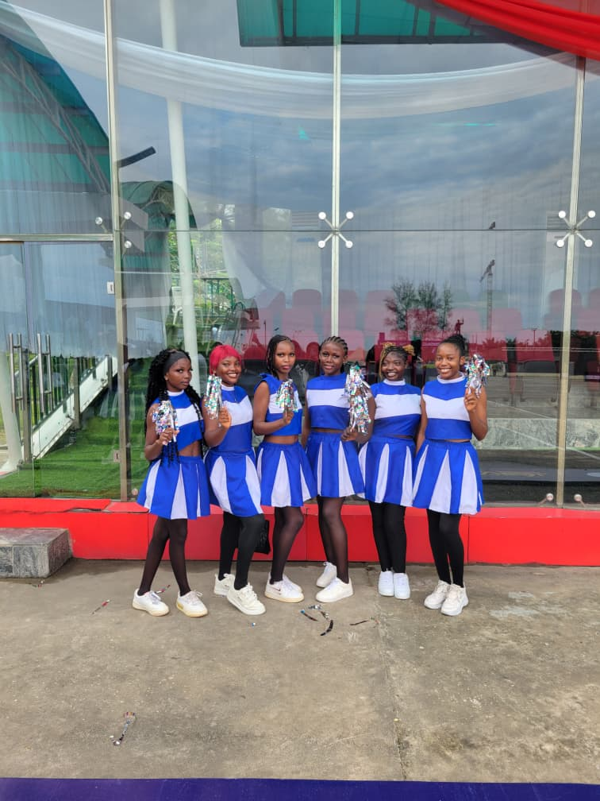
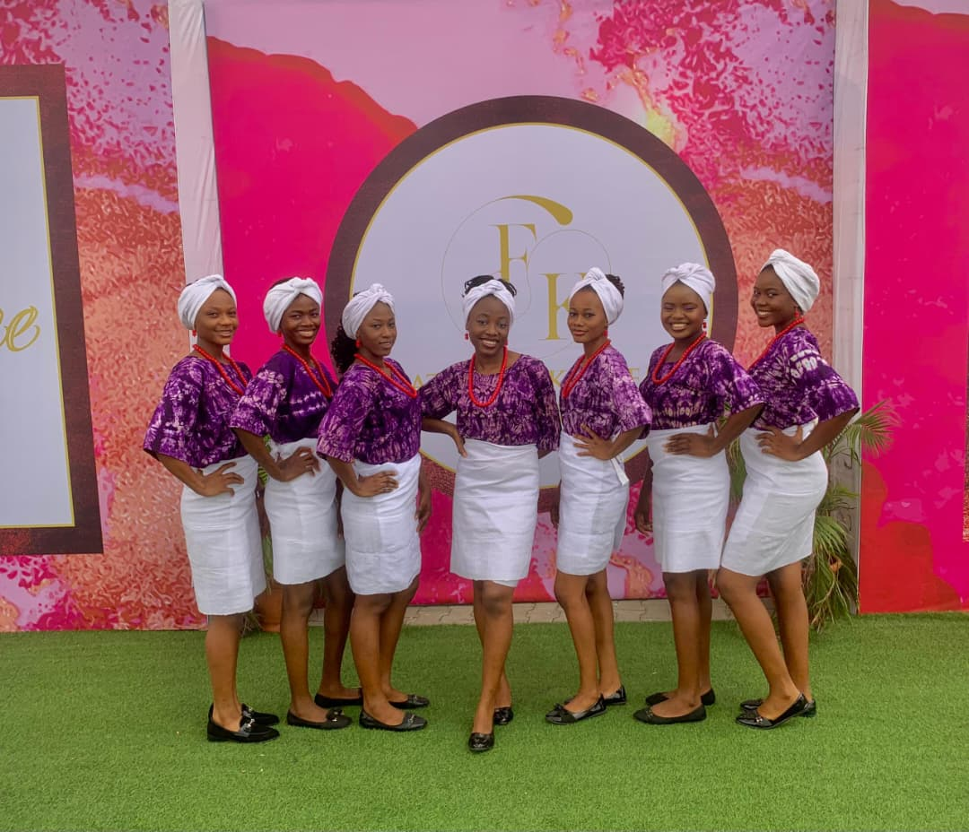
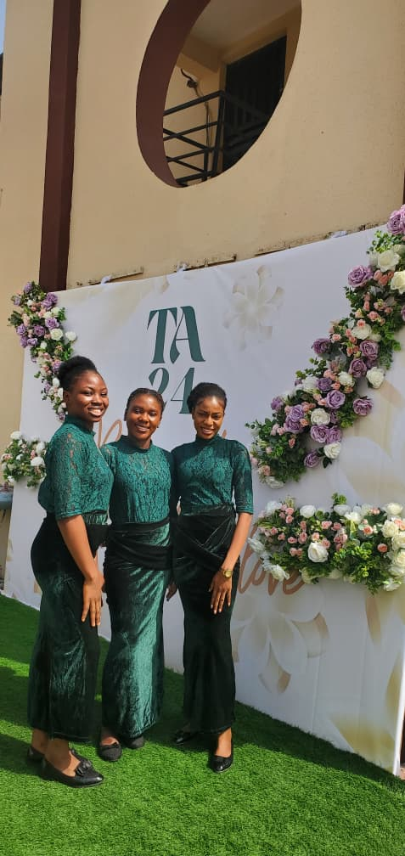
IN ACTION
Gallery & Testimonials
"
"
Hello Ms Reni, I just wanted to say thank you for providing the ushers and cheerleaders for our marathon. You and your team did an amazing job — especially the cheerleaders. Their energy, smiles, and constant cheering at the finish line kept the runners motivated. Looking forward to working with Reni's Gallery on our next marathon.
As an event planner, it's a relief working with a team that understands what needs to be done without constant supervision. Thank you for making my job easier. I look forward to working with Reni's Gallery again!
Mr. Emmanuel, Project Manager — Nilayo Sports Management Limited
Mr. Kewe, Dari Managers Events
RENI'S GALLERY LTD.
09

Slide 10
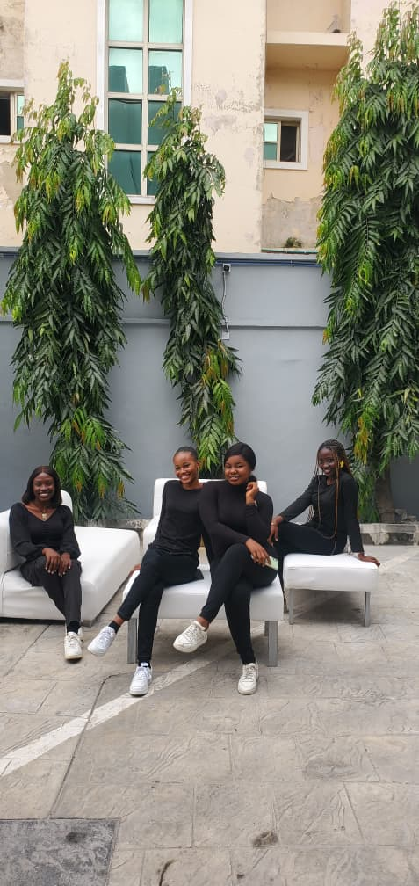




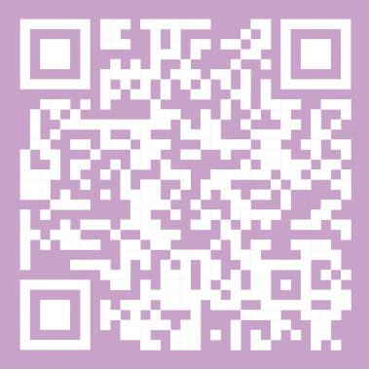
Let's Create Exceptional
Guest Experiences Together
Whether you're hosting an AGM, wedding, birthday, conference, product launch, sporting event, or executive gathering, Reni's Gallery provides the professional people who help your event run smoothly from arrival to departure.
+234 813 018 0075
renisgallery@gmail.com
@renisgallery
Reni's Gallery Ltd.
Scan to view our profile online
Where Hospitality Meets Style.

